Slide 1
Project 3 -
Dining Philosophers Problem
Authors: Gabriella Garcia, Xiana Lara, Antonio Maldonado, Phillip Powell

Slide 2
Abstract
This Project discusses the Dining Philosophers Problem. The problem is, there are x amount of philosophers and x-1 amount of chopsticks. This problem shows the natural problems that occur in resource allocation when there are fewer resources than processes that require the resource. Our program shows philosophers thinking, hungry, picking up chopsticks, and eating. We used semaphores in our project to protect critical sections during resource allocation. To help us allocate our resources we have methods for eating, taking a pair of chopsticks, putting the chopsticks down, and the philosophers.

Slide 3
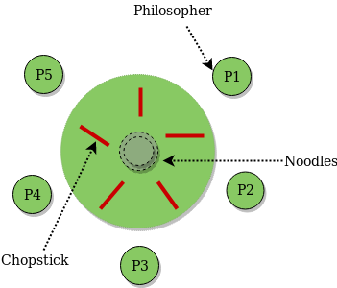
Introduction
The Dining Philosophers problem was the fifth project proposed to us by Dr. Wang. The problem is that there are x-amount of philosophers and x-1 amount of chopsticks. To solve this, we needed to figure out how to allocate resources when there isn’t enough of them, in this case, the chopsticks. We must look out for deadlocks while allocating our program, because it could cause our program to crash. We learned that delays were very useful in preventing deadlocks, and that semaphores are great for protecting critical sections while allocating, dellocating and consuming resources.

Slide 4
Methodology - Variables
Our experiment utilizes five global variables:
Three statuses of each philosopher: Eating, Thinking, and Hungry.
A semaphore, Mutex, to protect the critical section.
A semaphore array to control the status of the philosophers.

Slide 5
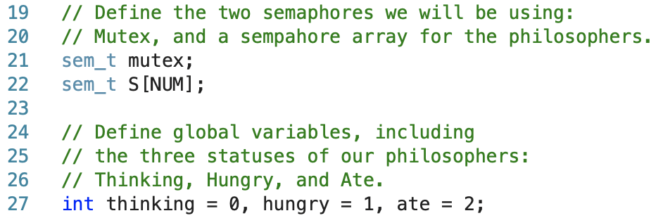
Methodology - Variables (cntd.)

Slide 6
Methodology - Functions
The “eating” function checks if the status of x-philosopher is starving and both chopsticks on both sides of the philosopher are not being used. After this condition check, the function will change the state of x-philosopher to eating, and sleep for 2 seconds. A print statement to the terminal will display which philosopher has taken the chopsticks and begun eating. Then the semaphore that is responsible for the philosopher will be unlocked.

Slide 7
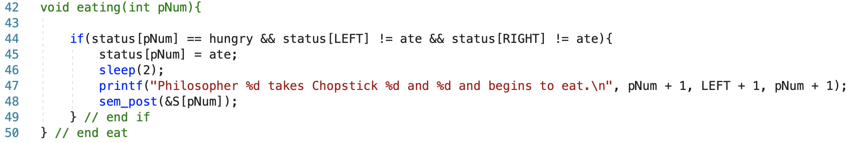
Methodology - Functions (cntd.)

Slide 8
Methodology - Functions (cntd.)
The “takeChopsticks” function uses a semaphore to protect the critical section by utilizing a mutex. First we call sem_wait on the mutex, which is a lock for the semaphore. Then we check to see if the state of x-philosopher is starving using the “eat” function above, passing the n-philosopher’s index to the function. Afterwards we close the critical section and lock the semaphore array.

Slide 9
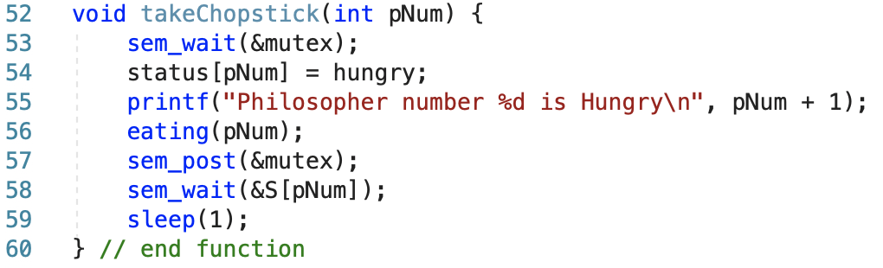
Methodology - Functions (cntd.)

Slide 10
Methodology - Functions (cntd.)
The “placeChopstick” function uses the mutex semaphore and checks to see if the philosopher’s state is “thinking”. If so, the philosopher will place their chopsticks down and it will print to the terminal that n-philosopher is thinking.

Slide 11
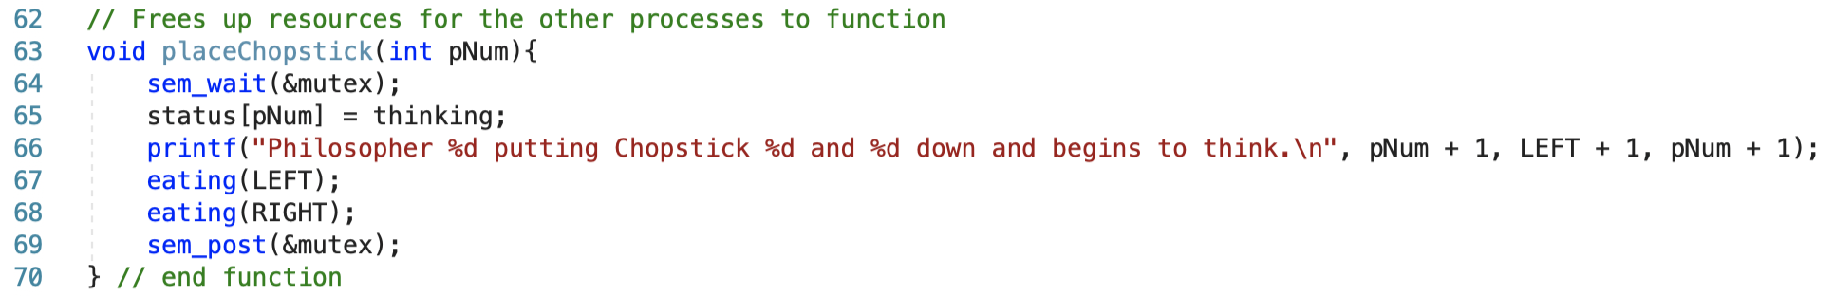
Methodology - Functions (cntd.)

Slide 12
Methodology - Functions (cntd.)
The “philosopher” function is simple but depends on each method prior. It is used exclusively for each thread. It involves setting a pointer equal to the pointer value passed, and sending that to both the “takeChopsticks” and “placeChopsticks” functions. There is a sleep between each to ensure there’s no overlap with the threading process.

Slide 13
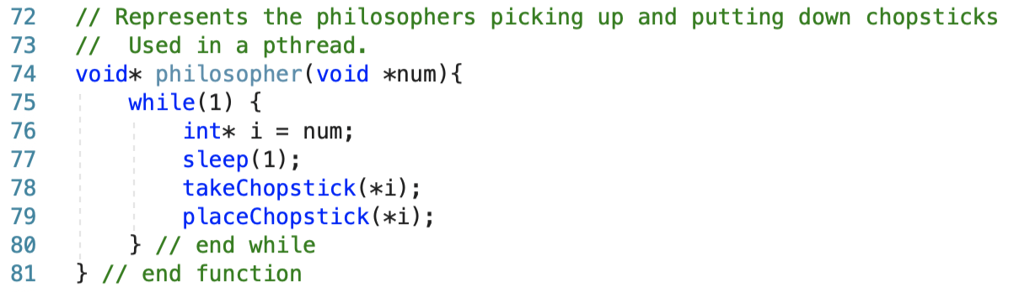
Methodology - Functions (cntd.)

Slide 14
Methodology - Functions (cntd.)
The “main” function initializes the semaphores used and their respective threads. Using a for loop, the threads are created based on the x-amount of philosophers.

Slide 15
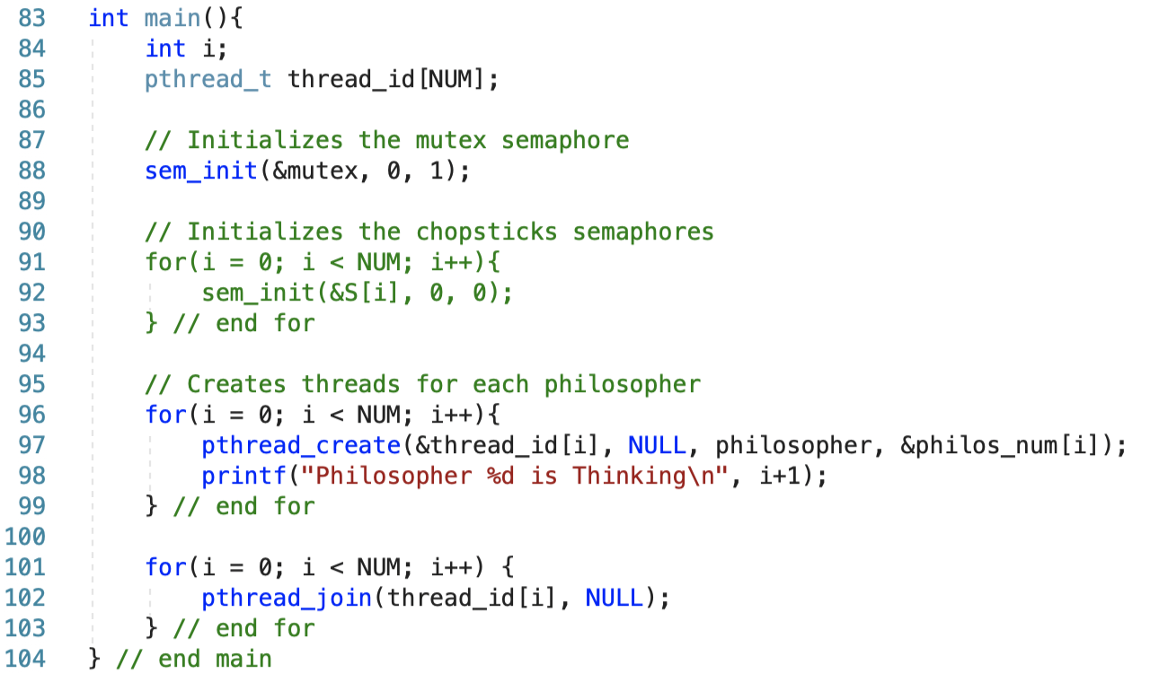
Methodology - Functions (cntd.)

Slide 16
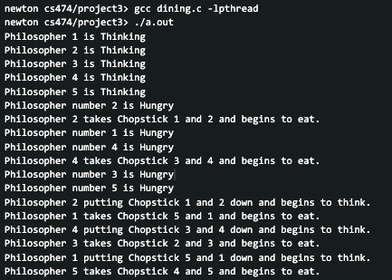
Output
*This is not all of the output, but encapsulates most of it

Slide 17
Conclusion
The Dining Philosophers Problem showcases the limitations and issues with resource allocation when there is less resources than processes. To create a solution for this problem we used a function to delay the time between processes. The delay allows the philosopher to finish eating and place down the chopsticks so that others can use it. Using this delay prevents cases of deadlock which would eventually crash a system. Semaphores were used to protect the critical sections that involve resource allocation, deallocation, and consumption. In conclusion, our team has learned the importance of deadlock prevention, because deadlocks can potentially crash a system or prevent processes from functioning, which sometimes can be a critical process needed.

